Slide 1
Intro to Networks
UT LAW 379M
Fall 2021
Lecture Notes

Slide 2
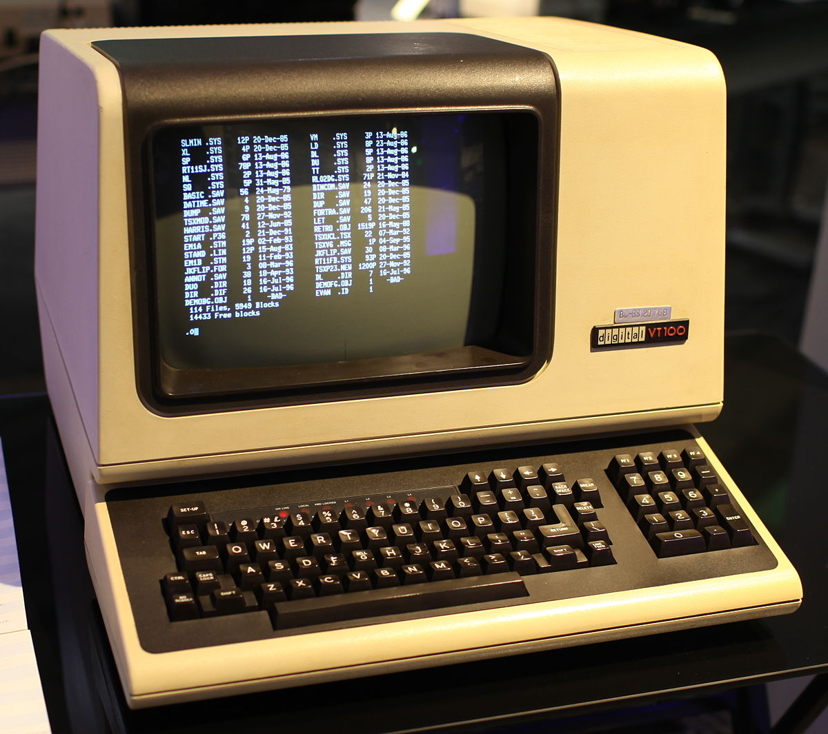

Computing 1960-1980 (ish)
NETWORK
This Photo by Unknown Author is licensed under CC BY-SA-NC
“DUMB” TERMINAL
MAINFRAME
Basically, just a keyboard and monitor
All the processing (computer brains) happens here
This Photo by Unknown Author is licensed under CC BY-SA

Slide 3
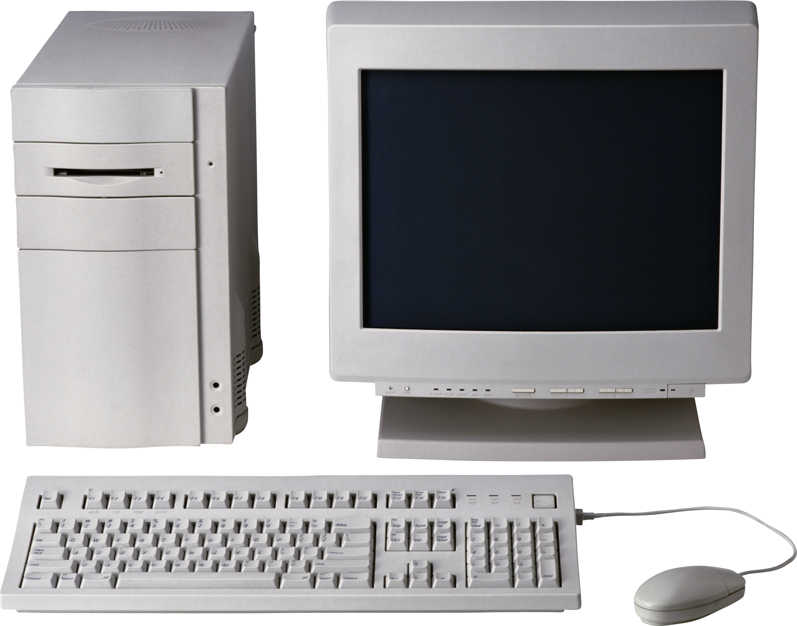
Computing 1980-2000 (ish)
For the most part, NO NETWORKING
This Photo by Unknown Author is licensed under CC BY-NC

Slide 4
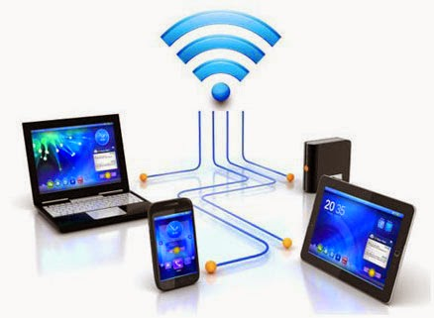
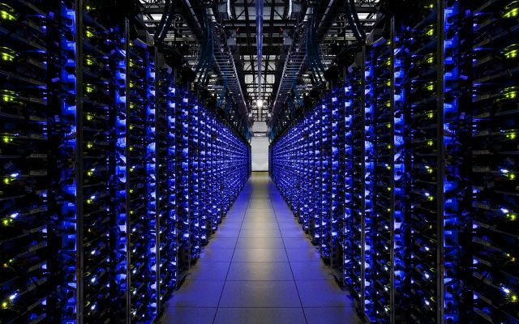
Computing 2000 – Present
NETWORK
This Photo by Unknown Author is licensed under CC BY
This Photo by Unknown Author is licensed under CC BY-NC-ND

Slide 5
ADDRESS: A
ADDRESS: B
TO: B
FROM: A
{DATA}
TO: A
FROM: B
{DATA}

Slide 6
What is a Protocol?
A protocol is the set of rules that govern the interaction of two or more parties
In the context of networking, it defines how two nodes (like client and server) communicate
When a party can communicate
What a party can communicate, including message structure
How a party responds to received communications
Certain outcomes or results are guaranteed when the rules are followed

Slide 7
Overloaded Term
Actually, a protocol often refers to two separate things
FIRST, the rules/specification referred to on the previous slide
SECOND, the computer module that implements the rules

Slide 8
Common Contemporary Protocols
HTTP – HyperText Transfer Protocol
IP – Internet Protocol
SMTP – Simple Mail Transport Protocol

Slide 9
One Protocol is not Enough
There are too many rules for any one protocol to handle
Also, behavior/rules need to change for different hardware/goals
OSI defined a conceptual “stack” of protocols.
Each protocol “layer” can push data down to a lower layer, or pop data up to a higher layer
The protocol on one machine (e.g., client) is a “peer” with the same protocol on the other machine

Slide 10
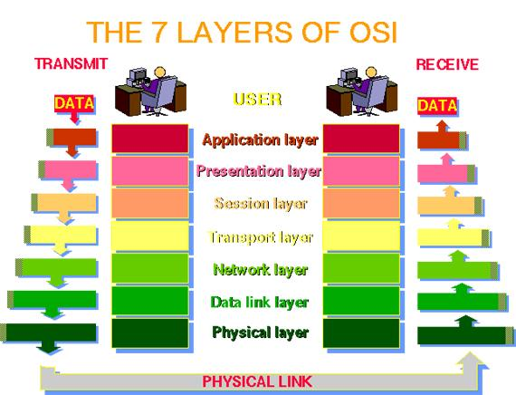

Slide 11
The OSI Model in Practice
Very few systems follow the seven-layer “ideal”
Mostly just care about TCP/IP and the following layers:
Application (Layer 7; example: HTTP)
Transport (Layer 4; TCP)
IP (Layer 3; IP)
Data Link (Layer 2; example: Ethernet or Wifi)
NOTE: It’s common to just refer to a layer by it’s number (e.g., a layer-4 protocol)

Slide 12
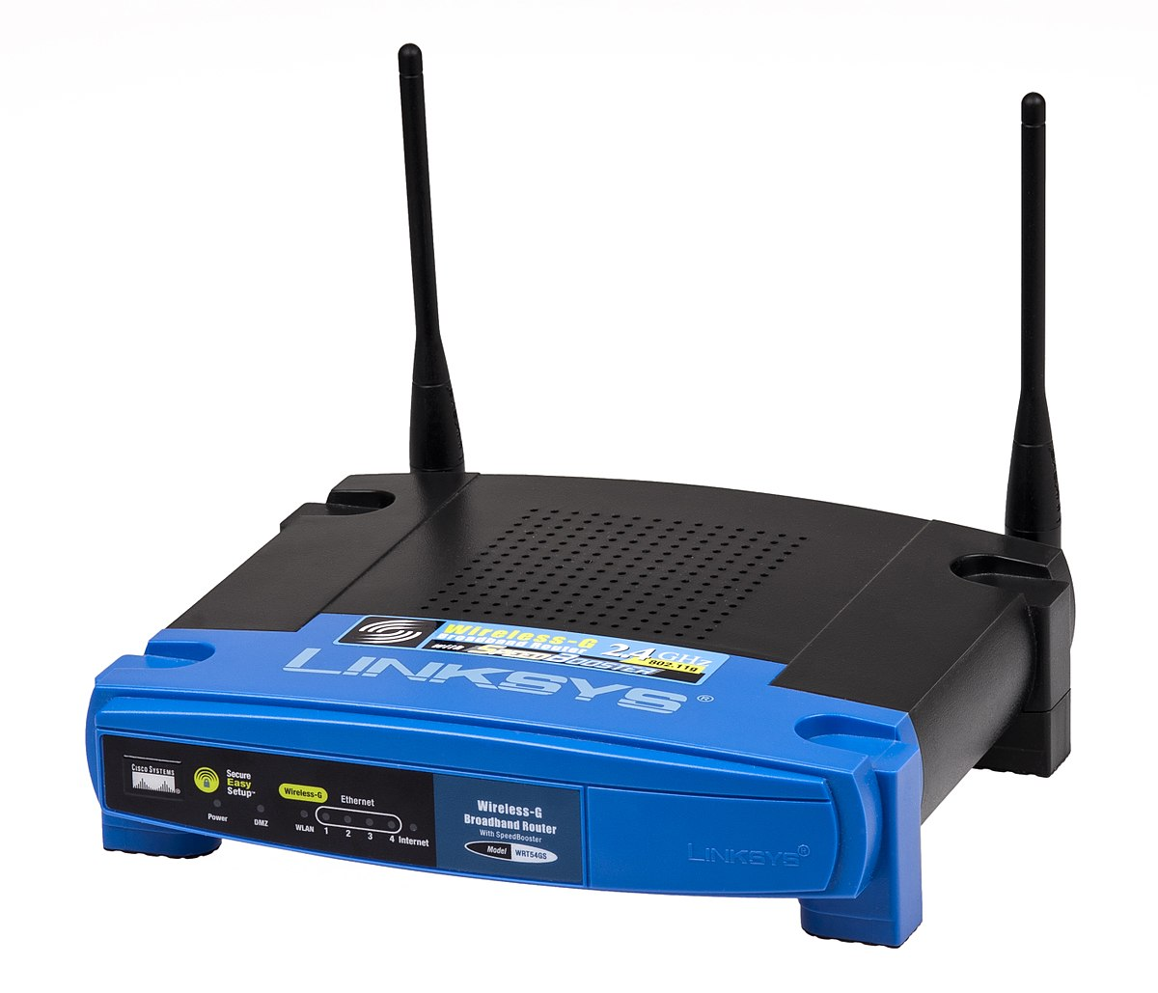
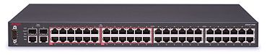
Monolithic vs Modular
HTTP Monolith Ethernet
HTTP Monolith
Wifi
HTTP
TCP
UDP
IP
Ethernet
WiFi
This Photo by Unknown Author is licensed under CC BY-SA
This Photo by Unknown Author is licensed under CC BY-SA

Slide 13
Division of Labor in TCP/IP
At the MAC layer, protocol connects 2 endpoints. Typically:
Has its own addressing scheme (MAC address)
Controls who talks when
Provides error detection and error correction
IP (Internetwork Protocol)
Connects many different networks of different media types
Global addressing scheme
TCP
Reliable, in-order delivery (Session)
Multiplexing

Slide 14
Local Network Concepts
Local Area Network (LAN) – Direct node-to-node connection
Usually involves a “medium”, hence Medium Access Control
Nodes can send or receive MAC packets w/ MAC addresses
Broadcast typically used for discovery

Slide 15
ADDRESS: C
ADDRESS: A
SWITCH
ADDRESS: B
TO: B
FROM: A
{DATA}
ADDRESS: D
Message from A on port 1. No idea where B is yet…

Slide 16
ADDRESS: C
ADDRESS: A
SWITCH
ADDRESS: B
TO: B
FROM: A
{DATA}
ADDRESS: D
Send message to all ports except port 1

Slide 17
ADDRESS: C
TO: A
FROM: B
{DATA}
ADDRESS: A
SWITCH
ADDRESS: B
ADDRESS: D
B is sending a message on port 3. I’ll remember that…

Slide 18
ADDRESS: C
TO: A
FROM: B
{DATA}
ADDRESS: A
SWITCH
ADDRESS: B
ADDRESS: D
Sending message to port 1, because that’s where A was last time

Slide 19
IP Address Mapping
MAC addresses are great, but app layer doesn’t use them
Even when communicating on your LAN, you use IP addrs
To communicate, IP-to-MAC address mapping required
Enter the Address Resolution Protocol (ARP)

Slide 20
In Class Exercise
Find your computer’s
IP Address
MAC Address
Gateway

Slide 21
Internetworking Concepts
We’ve covered how to talk to a LAN node.
What about a node outside our broadcast domain?
Requires internetwork routing

Slide 22
Exiting the LAN
A gateway node is connected to TWO+ LANs
For any external IP address, use the MAC addr of the gateway
(True dest IP addr remains the same!)
Gateway node will examine the dest IP addr
Gateway node determines where to send the data next

Slide 23
LAN 1 LAN 2
IP Packet
SRC: W
DST: M
IP Packet
SRC: W
DST: M
ARP TABLE:
GW <-> MAC B
ETHERNET PROTOCOL
ETHERNET PROTOCOL
ETHERNET PROTOCOL
ETHERNET
SRC: A, DST: B
ETHERNET
SRC: B, DST: C
ETHERNET
SRC: B, DST: C
SRC: W, DST: M
SRC: W, DST: M
SRC: W, DST: M
IP: W
MAC: A
(GW) IP: X
MAC: B
IP: M
MAC: C

Slide 24
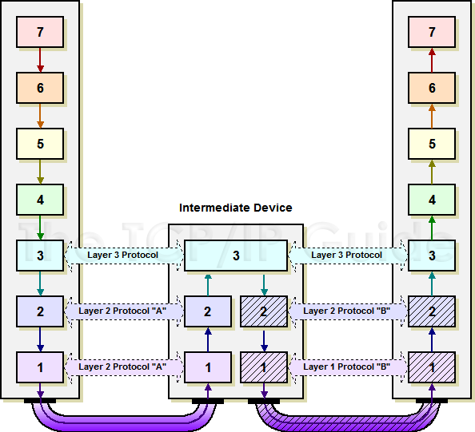
http://www.tcpipguide.com/free/t_IndirectDeviceConnectionandMessageRouting.htm

Slide 25
Routing Across the Internet
Data may have to move up a hierarchy
You to a Tier-3 ISP to a Tier-2 ISP, to a Tier 1 ISP
Top level ISP’s usually manage the “Autonomous Systems” (AS)
AS’s are the top level of the Internet in terms of routing
AS’s are interconnected and represent the “backbone”

Slide 26
In Class Exercise
Web-based “traceroute”

Slide 27
General Ideas Behind Client-server
Put a bunch of resources in a high-performance, centralized machine (SERVER)
Clients can be much “dumber” by comparison
Much more efficient
Sharing data between devices, applications, and people (and marketing)
Access from multiple locations (including hackers!)
Time-sharing a central machine is more scalable and cost-effective

Slide 28
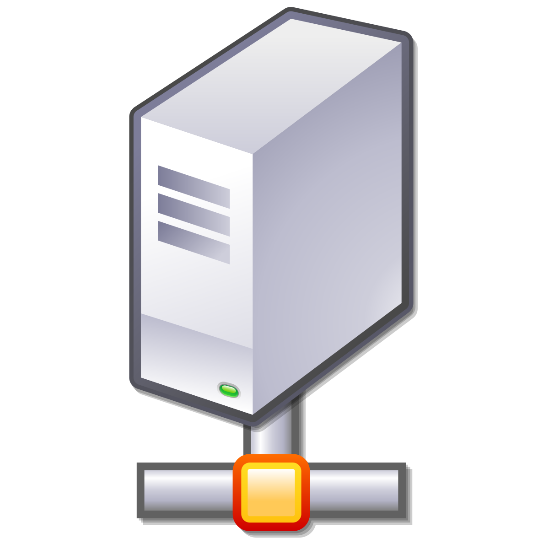
Confusing Meaning of “Server”
Server sometimes refers to the actual physical machine
Server sometimes refers to the computer program that provides service
A machine is a “server” if it has 1+ server programs running
Web Server
Program
Game Server
Program
This Photo by Unknown Author is licensed under CC BY-SA

Slide 29
Server Abstraction
I’m Lonely. I wish someone would talk to me!
This Photo by Unknown Author is licensed under CC BY-SA
SERVER (Program) LISTENS FOR INCOMING REQUESTS

Slide 30
Addresses Needed
The server can’t receive a request without an “address”
Typically identify machines with an Internet Protocol (IP) address
Typically identify programs on the machine with a “port”
TCP ports are for guaranteed delivery, like for file transfer (most common)
UDP ports are for best-effort delivery, like streaming music or games

Slide 31
Addresses and Ports
Address is kind of like the address of a building
Port is kind of like the apartment number

Slide 32
IP (Version 4) Address
Although IP Version 6 addresses are in use…
IP Version 4 addresses are still pretty common
172.217.1.142
Type this in your browser!
Four numbers between 0 and 255
(separated by “.”)

Slide 33
Ports Allow Multiple Servers
80 – Unencrypted web traffic
443 – Encrypted web traffic
25 – Email data tranfer

Slide 34

Assigning an Address and Port
Now I have an Address/Port! Maybe I’ll get Requests!
IP: 192.168.0.1
PORT: 80
This Photo by Unknown Author is licensed under CC BY-NC
This Photo by Unknown Author is licensed under CC BY-SA
SERVER HAS AN IP ADDRESS AND TCP PORT

Slide 35
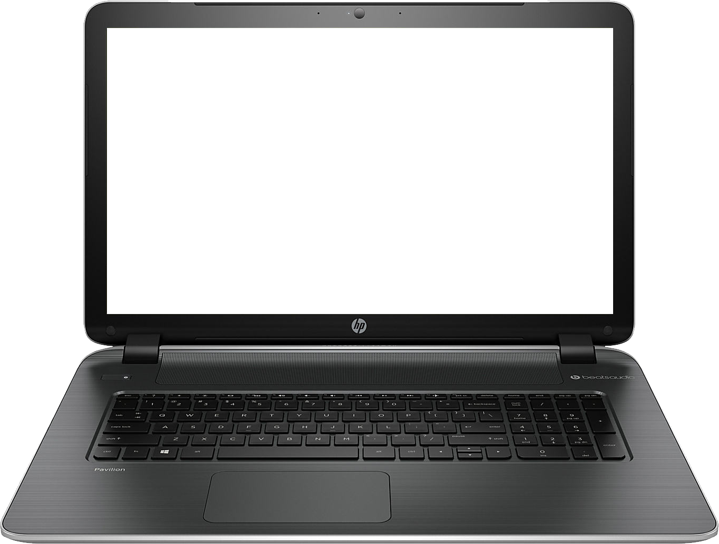
Meanwhile, Client Abstraction
HELLO?!
This Photo by Unknown Author is licensed under CC BY-NC
CLIENT (program) CONNECTS TO MAKE OUTBOUND REQUESTS

Slide 36

Client (program) Needs Return Address
HELLO?!
TO: 192.168.0.1:80
FROM: 192.168.0.2:5280
Usually arbitrary, picked
by operating system
This Photo by Unknown Author is licensed under CC BY-NC
This Photo by Unknown Author is licensed under CC BY-NC
CLIENT (program) CONNECTS TO MAKE OUTBOUND REQUESTS

Slide 37
Incoming Request
I GOT A REQUEST!!!
REQUEST
TO: 192.168.0.1:80
FROM: 192.168.0.2:5280
This Photo by Unknown Author is licensed under CC BY-SA
SERVER RECEIVES REQUEST

Slide 38
Request Response
MY NEW PENPAL!
RESPONSE
TO: 192.168.0.2:5280 FROM: 192.168.0.1:80
This Photo by Unknown Author is licensed under CC BY-SA
SERVER INVERTS TO/FROM FOR RESPONSE

Slide 39
TCP/IP Send Example
User enters “google.com” into browser
(computer converts “google.com” to an
IP address first).
HTTP is the protocol used for sending/receiving data to/from websites.
TCP deals with making sure the data gets to the right server program correctly
IP is used for getting data over the Internet to the correct machine
MAC is used for communicating on Wifi or Ethernet
HTTP
HTTP Request
TCP
TCP
HTTP Request
IP
IP
TCP
HTTP Request
MAC
MAC
IP
TCP
HTTP Request
Headers. Typically meta data such as “to”, “from”, etc.

Slide 40
TCP/IP Receive Example
Web server program begins gather the requested info. When it has it, it will respond by sending a new message down the stack in the reverse direction
As each layer processes the data, the headers are stripped off. The MAC layer removes the MAC header, the IP layer removes the IP header, etc., before passing the data up. Each layer may or may not need to do some processing based on information in the header.
HTTP Request
HTTP
TCP
HTTP Request
TCP
IP
TCP
HTTP Request
IP
MAC
IP
TCP
HTTP Request
MAC
Conceptually, data arrives at the bottom of the stack
and is processed and then “popped” up to a higher layer

Slide 41
What is the World Wide Web?
Internet - globally interconnected network system
World Wide Web - HTTP-based content, apps, “ecosystem”

Slide 42
Key Tech: Domain Name System (DNS)
IPv4 addresses were hard to remember/use
IPv6 are worse
Humans need semantically meaningful addresses
DNS maps IP addresses to domain names

Slide 43

Basic Idea
Where is “google.com?”
142.250.138.138
DNS SERVER
http://google.com
GET / HTTP/1.1
142.250.138.138
(google.com)

Slide 44
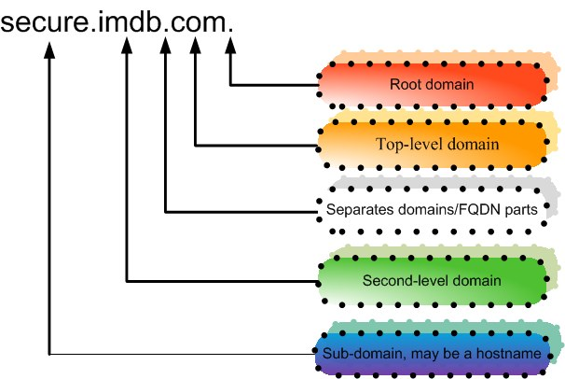

Slide 45
Top Level Domains (TLDs)
Generic Top Level Domain (gTLD) - .com, .net, et
Country code Top Level Domain (ccTLD) - .uk

Slide 46
TLD Name Management
Registrars administer TLDs
For gTLDs, this is a business with pros and cons
Registrars authorize “domain name registrars”

Slide 47
Domain Name Registration
Party requests SLD + TLD from domain name reseller
Party submits “whois” information (contact info)
Registrar verifies that name is available
Registrar stores relevant data in registry and DNS servers

Slide 48
DNS and Address Resolution
DNS is a recursive and hierarchical process
Recursive – DNS server searches another DNS server
Hierarchical –
Root Domain to TLD
TLD to Subdomain

Slide 49
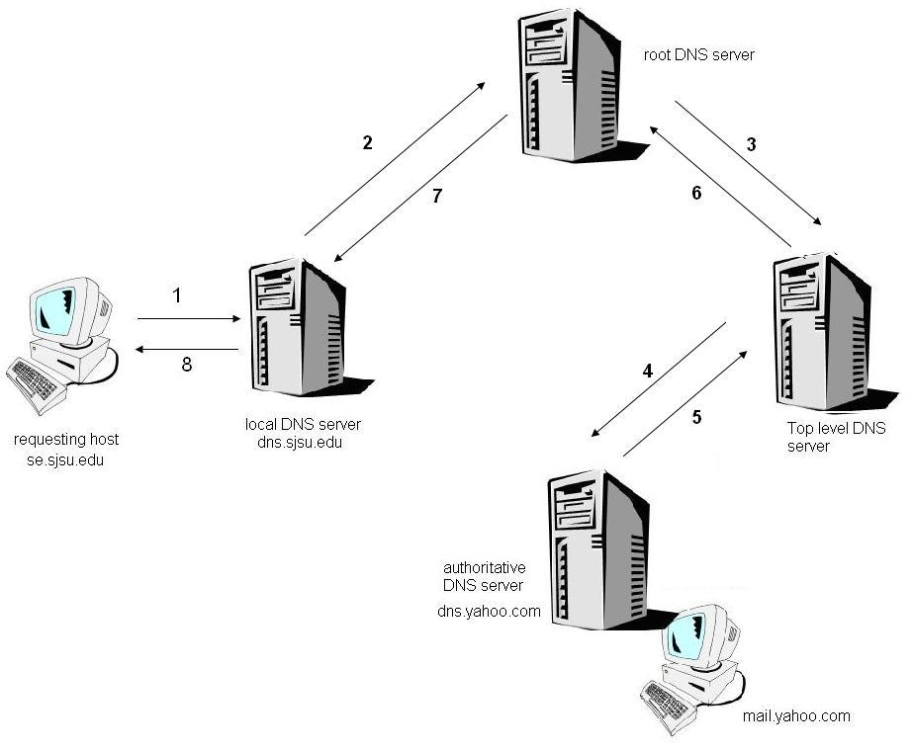

Slide 50
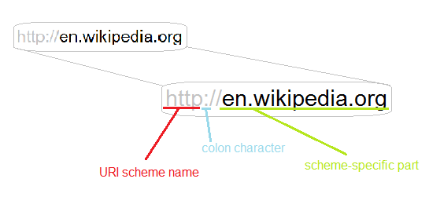
Uniform Resource Identifiers (URIs)

Slide 51
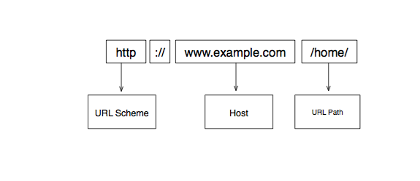

Slide 52
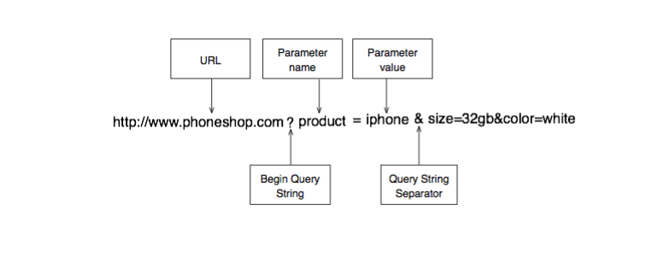

Slide 53
Absolute vs Relative URI
Absolute paths begin with <scheme>://host/
e.g., http://www.google.com/
Everything else is relative
e.g., /not/an/absolute/path
The scheme and host are determined by context

Slide 54
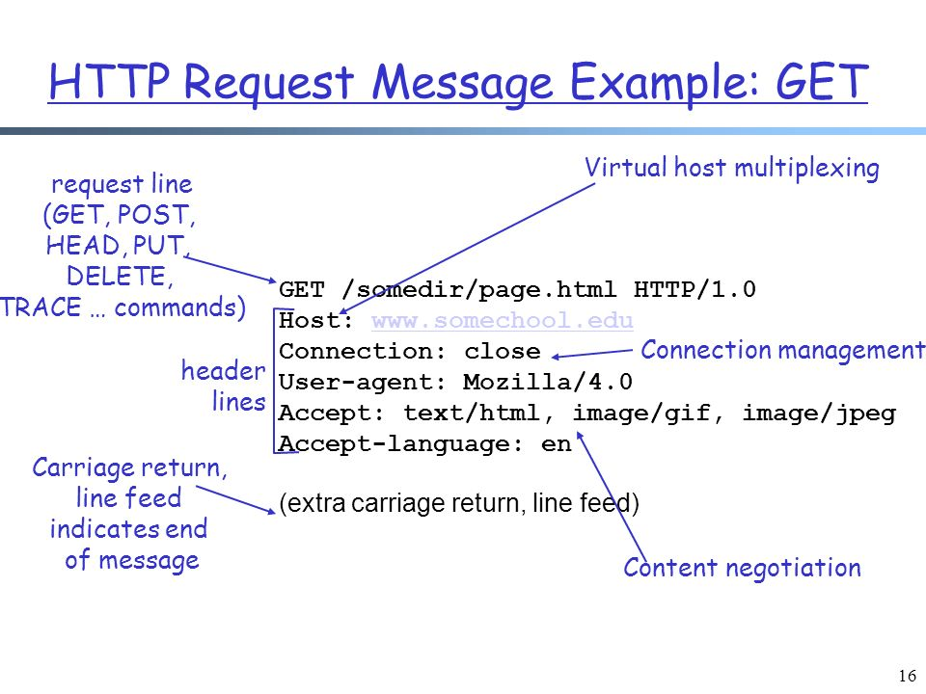
HTTP Request

Slide 55
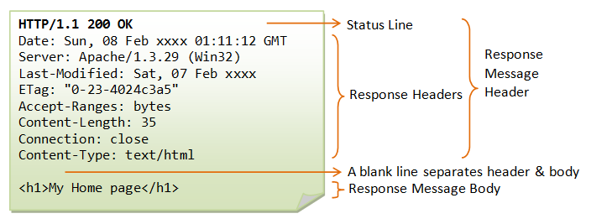
HTTP Response

Slide 56
Static Web Page Example
<HTML>
<BODY>
<H1>Simple Web Page</H1>
<IMG SRC=“/images/image1.jpg”>
</BODY>
</HTML>

Slide 57
Rendering a Web Page
Browser requests HTML “root” page
Root page has links for images, etc
Browser requests embedded objects
Browser integrates and renders objects

Slide 58
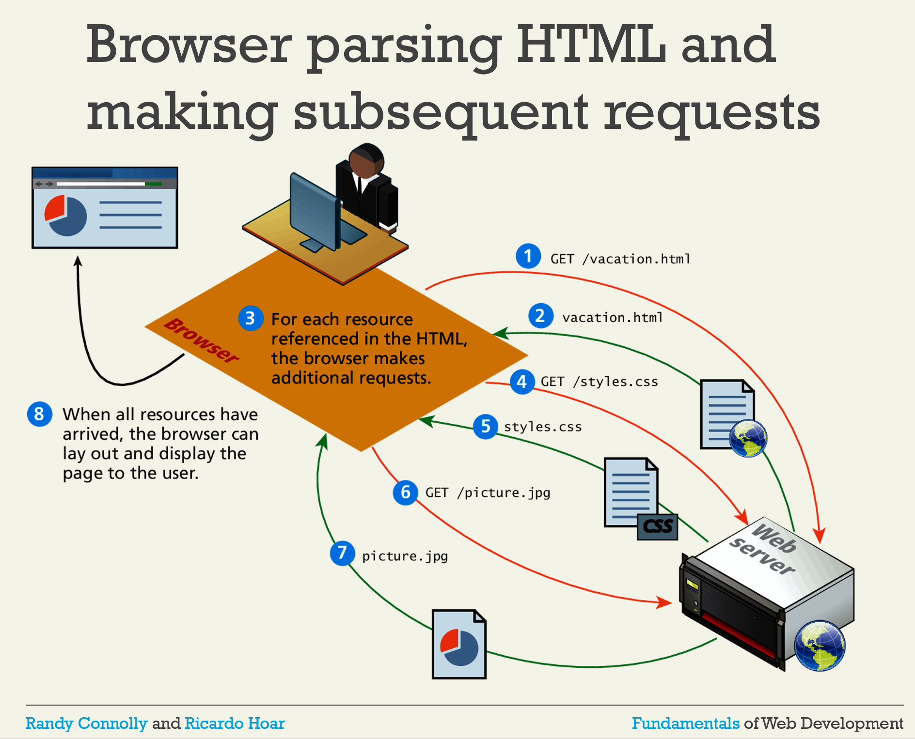

Slide 59
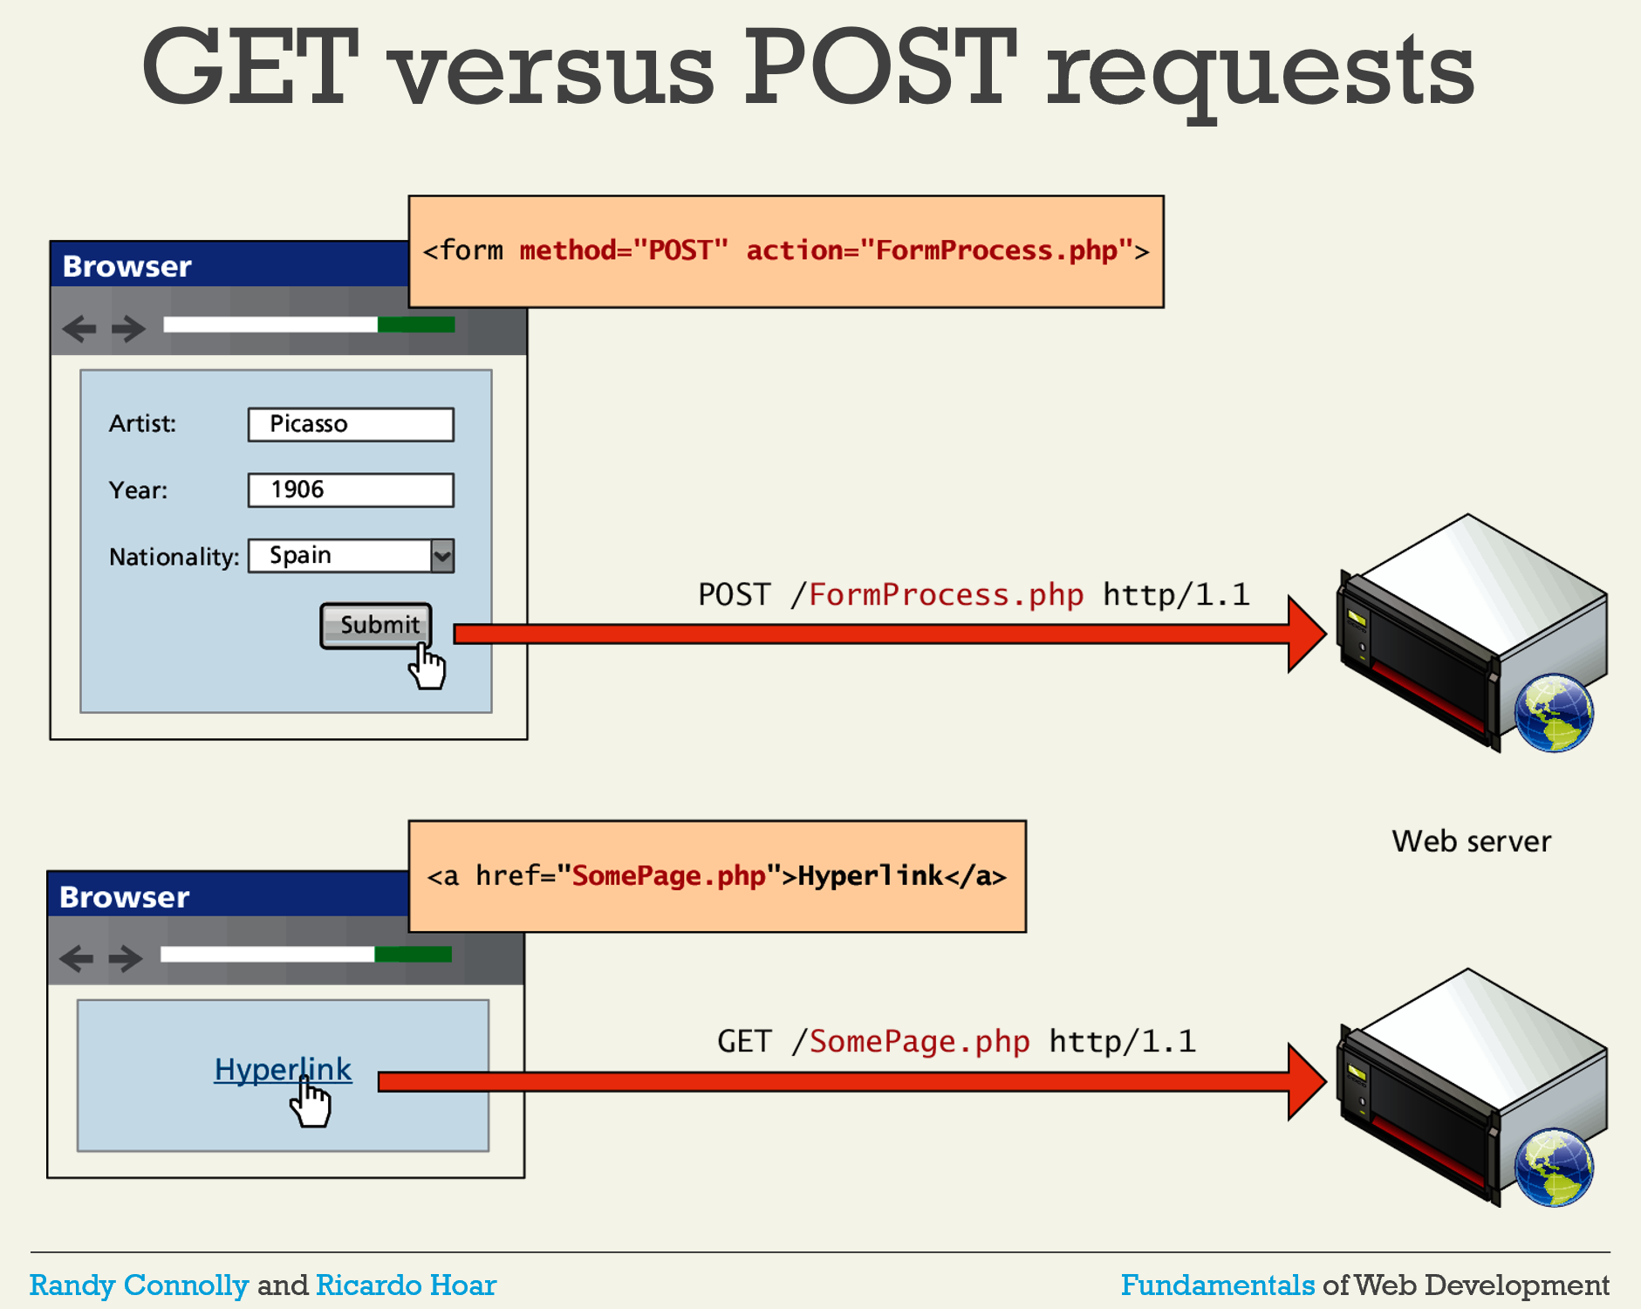

Slide 60
Web Stack
The “stack” of software needed to run a web server
Typically: O/S, web server, database, scripting engines, etc
Very Common: LAMP:
Linux
Apache
MySQL DB
PHP

Slide 61
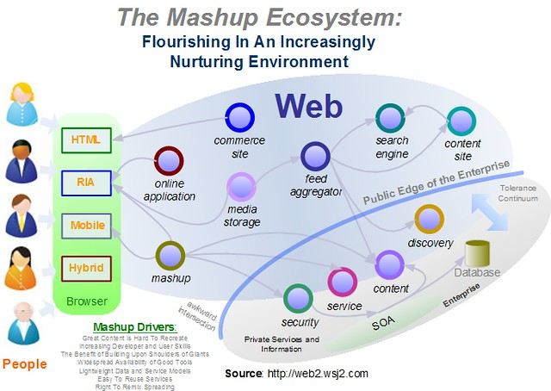
Web 2.0 and Beyond

Slide 62
Cookies
HTTP is STATELESS
A webserver doesn’t “connect” requests
To simulate a “session”, use cookies
Put “cookie: <session id>” in request/response header

Slide 63
In-Class Exercises
Wireshark

